Slide 1




Slide 2
Internship theme
Sizing and integration of EVSE (IRVE) terminals on the ENEDIS distribution network

Slide 3
TABLE OF CONTENTS
Introduction
Enedis' Presentation
Tasks' Description
Conclusion

Slide 4
Introduction
Context of the internship: Internship as part of my second year in BUT Electrical Engineering and Industrial Computer Science at the IUT of Aisne as a project manager trainee
Purpose of the internship: Gain experience in the sizing and integration of EVSE (Electric Vehicle Supply Equipment) charging stations and learn more about the position of project manager

Slide 5
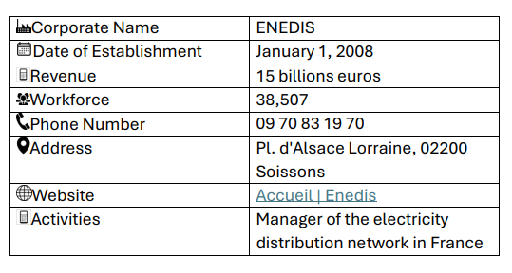
Enedis' Presentation

Slide 6
Enedis' Presentation
Structure:
  Management Board : Chairman of the Management Board Marianne Laigneau
  and
  Supervisory Board : Chairman of the Supervisory Board Véronique Lacour

Slide 7
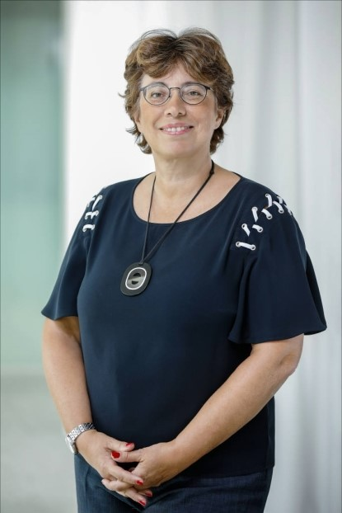
Enedis' Presentation
Marianne Laigneau - Chairman of the Management Board

Slide 8
Enedis' Presentation
Up to 10 technical departments :
  Management support
  Territories
  Human Resources
  Communication Innovation Digital & Collaborative
  Prevention Occupational Medicine Social Partners
  Performance Management BAG
  Customer relations Linky development
  Connection Engineering APACHE
  Operations
  Infrastructure assets

Slide 9
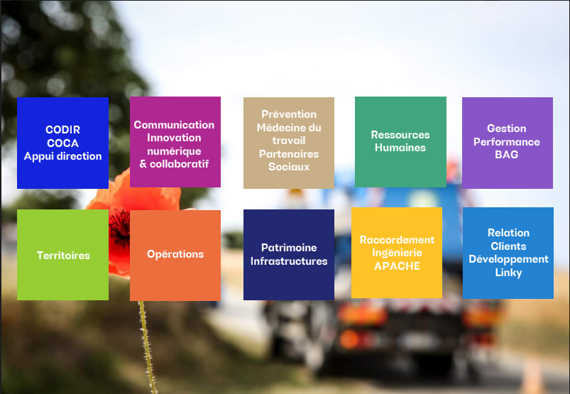
Enedis' Presentation
Enedis' Technical Departments

Slide 10
Tasks'
Description
My main tasks :
Sizing and integrating IRVE terminals into the distribution network
Study a project
Propose technical solutions
Manage a project portfolio from design to completion.

Slide 11
Tasks'
Description
Tools and software used :
RACING and ING-E-PILOT
OLIVIER
ROSANAT
E-PLANS

Slide 12
Tasks'
Description
Stages in the project design process :
Customer request
Processing of request by AARC (Customer Connection Center) or engineering department.
Drawing up an estimate and validation by the customer
Work performed by contractors

Slide 13
Tasks'
Description
Other tasks :
Participation in internal meetings
Site visits
Participate in workplace safety workshops
Going out into the field with the Live Wire Workers

Slide 14
Conclusion
Professionally and personally rewarding experience
Skills developed: Technical, organizational, interpersonal

Slide 15
Conclusion
Thank you for your attention

